Slide 1
2. Social Network Structure, Measures & Visualization
Amit Aylani

Slide 2
Contents
Basics of Social Network Structure - Nodes, Edges & Tie
Describing the Networks Measures - Degree Distribution, Density,
Connectivity, Centralization, Tie Strength & Trust
Network Visualization - Graph Layout, Visualizing Network features,
Scale Issues.
Social Media Network Analytics - Common Network Terms, Common
Social Media Network Types, Types of Networks, Common Network
Terminologies, Network Analytics Tools.

Slide 3
Basics of social network structure
Social network structure refers to the patterns of relationships and connections among a group of people or organizations.
Studying social network structure helps us understand how information, resources, and support flow within a group, and how this flow impacts the behavior and outcomes of individuals and organizations.
Social network analysis is a research methodology that uses mathematical and statistical techniques to analyze and visualize social network data.
By studying social network structure, we can gain insights into the structure and dynamics of social systems, and how these systems influence the behavior and outcomes of individuals and organizations within them.

Slide 4
Node in Social Media Network
A node refers to an individual, organization, or group that is represented by a point in the network.
A node is connected to other nodes by lines or edges, which represent relationships or connections between the nodes.
These connections can be based on various factors, such as friendships, familial relationships, shared interests, or professional connections.

Slide 5
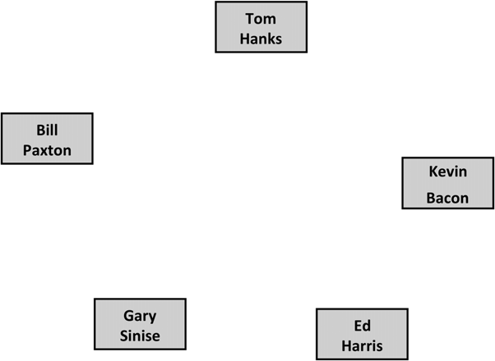
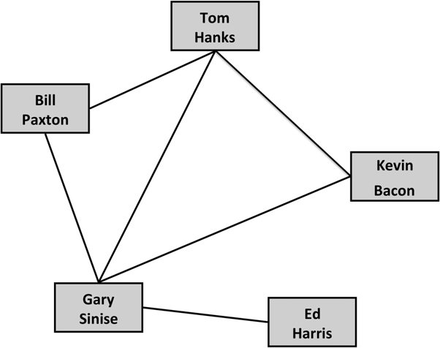
Node in Social Media Network
The five co-stars of Apollo 13. Each is represented as a node in the network.
The edges connect actors who were in movies together.

Slide 6
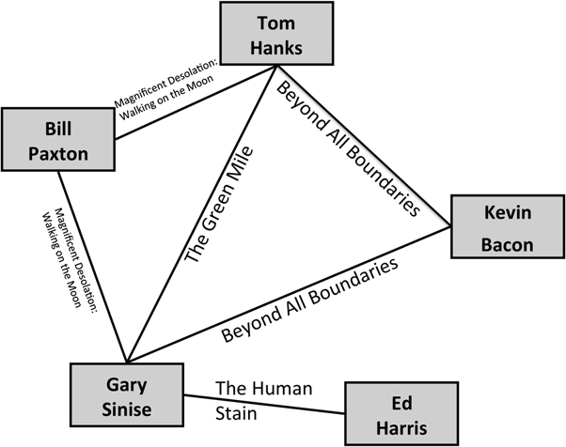
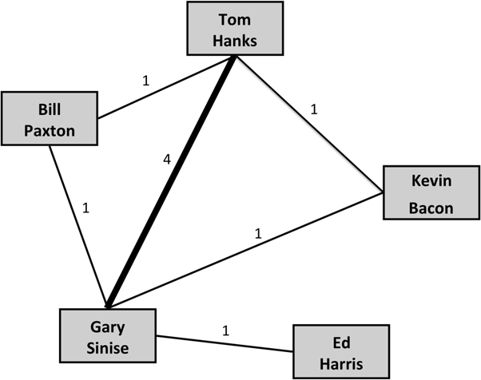
Undirected Graph
A weighted graph where weights are indicated both as numbers and by the thickness of the edge. In this graph, weight indicates how many movies the actors have been in together.
Edges indicate at least one movie that the actors have been in together, not including Apollo 13.

Slide 7
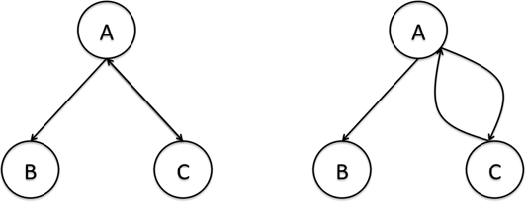
Directed Graphs

Slide 8
Representing Networks : Text Based Visualizations
Adjacency Lists
An adjacency list, also called an edge list. Each edge in the network is indicated by list- ing the pair of nodes that are connected. For example, the adjacency list for the Apollo 13 network is as follows:
Tom Hanks, Bill Paxton
Tom Hanks, Gary Sinise
Tom Hanks, Kevin Bacon
Bill Paxton, Gary Sinise
Gary Sinise, Kevin Bacon
Gary Sinise, Ed Harris

Slide 9
Representing Networks : Text Based Visualizations
Adjacency Lists
Adjacency lists can also include additional information about the edges
Tom Hanks, Bill Paxton, 1
Tom Hanks, Gary Sinise, 4
Tom Hanks, Kevin Bacon, 1
Bill Paxton, Gary Sinise, 1
Gary Sinise, Kevin Bacon, 1
Gary Sinise, Ed Harris, 1

Slide 10
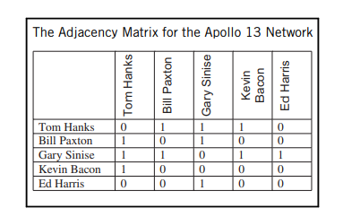
Adjacency Matrix

Slide 11
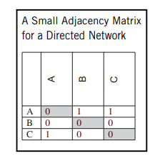
Adjacency Matrix for directed graph
Fig(1)

Slide 12
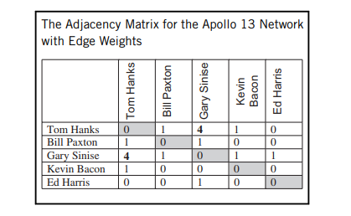
Adjacency Matrix for Undirected Weighted Graph
Fig(1)

Slide 13
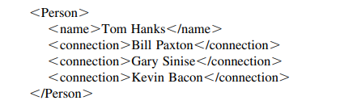
XML and standard format

Slide 14
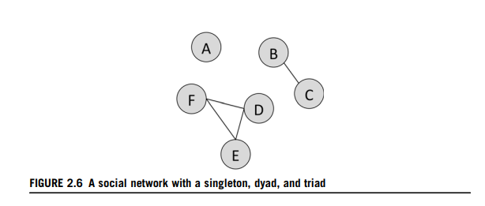
Basic Network Structure and Properties
Subnetworks
Subnetwork Types
Singleton
Dyad
Triad

Slide 15
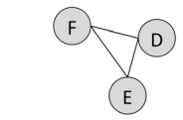
Cliques
All nodes in a group are connected to one another. When this happens, it is called a clique.

Slide 16
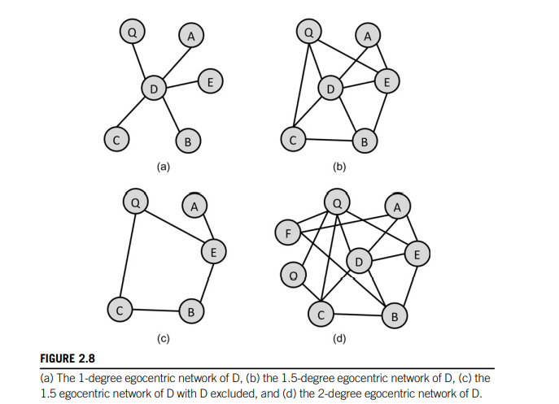
Egocentric networks
If we want to see only D’s neighbors and their connections, it is called a 1.5-degree egocentric network
As we are going one step away from D in the network, this is called a degree-1 egocentric network. It only shows us the nodes D is connected to.

Slide 17
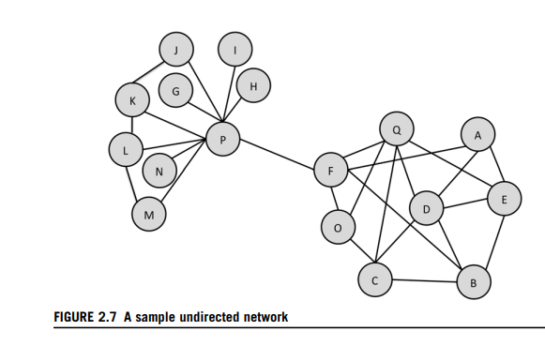
Paths and Connectedness
A path is a series of nodes that can be traversed following edges between them.
To determine the length of a path, we count the number of edges in it. The path from M to C has a length of 4 (MP, PF, FO, and OC)

Slide 18
Shortest Path
There are two shortest paths from Node F to Node E: FAE and FBE. Shortest paths will be an important measure we consider in network analysis and are sometimes called geodesic distances

Slide 19
Connectedness
Paths are used to determine a graph property called connectedness. Two nodes in a graph are called connected if there is a path between them in the network.
An entire graph is called connected if all pairs of nodes are connected.
Strongly connected graphs - every vertex is reachable from every other vertex.
Weakly connected - If a path cannot be found between all pairs of nodes using the direction of the edges, but paths can be found if the directed edges are treated as undirected, then the graph is called weakly connected.

Slide 20
Bridges and hubs
Connected Components -If a graph is not connected, it may have subgraphs that are connected. These are called connected components. The fig shows three-node connected component, a two-node connected component, and a singleton
A bridge is an edge that connects two otherwise separate groups of nodes in the network. Formally, a bridge is an edge that, if removed, will increase the number of connected components in a graph.
Hub - The term is used to refer to the most connected nodes in the network. E.g. Node P would be a hub because it has many connections to other nodes.

Slide 21
Bridges and hubs
Node P would be a hub
PF is a bridge

Slide 22
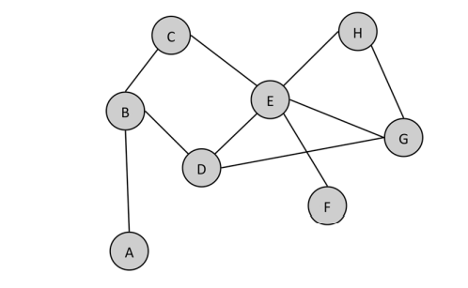
Exercise
1. Answer the following questions about this graph.
a. How many nodes are in the network?
b. How many edges are in the network?
c. Is this graph directed or undirected
d. Create an adjacency list for this graph.
e. Create an adjacency matrix for this graph
f. What is the length of the shortest path from node A to node F?
g. What is the largest clique in this network? How many cliques of that size are there?
h. How many connected components are there in this network?
i. Draw the 1.5 ego network for node E (without including node E in the graph). How many singletons are in the ego network?
j. Are there any hubs in the network? If so, which node(s) and why is it a hub?

